Slide 1
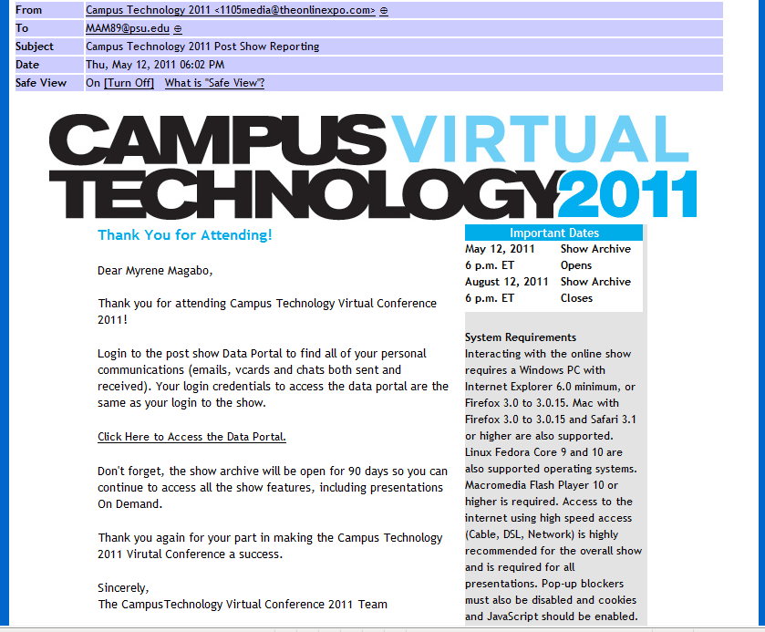

Slide 2
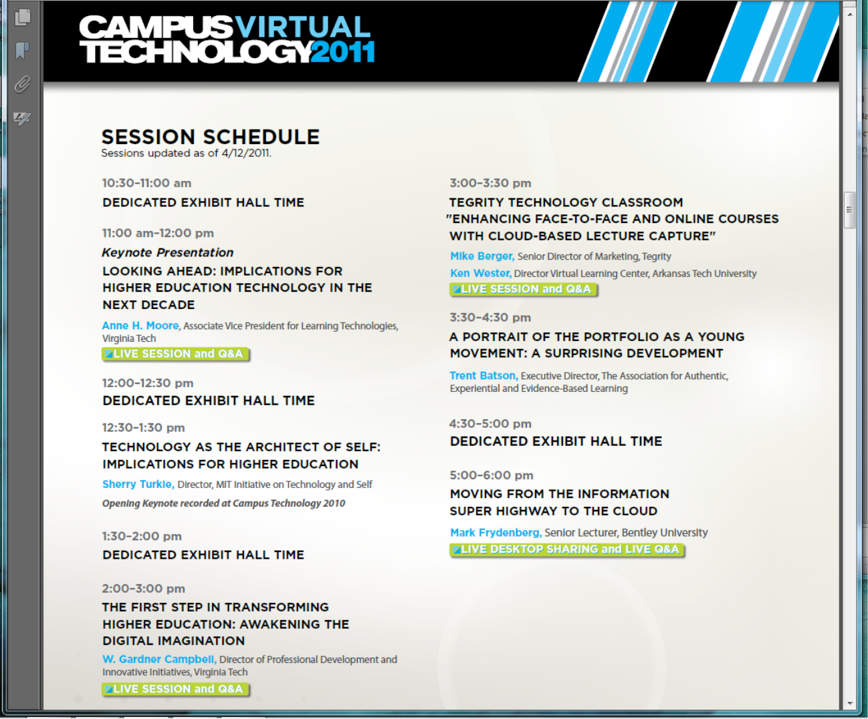

Slide 3


Slide 4

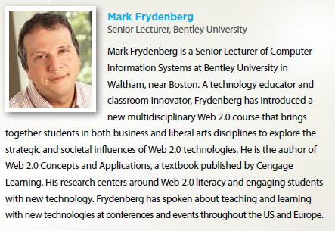
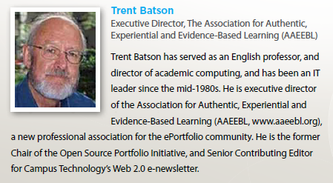
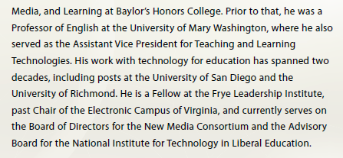

Slide 5
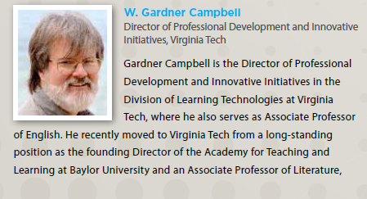
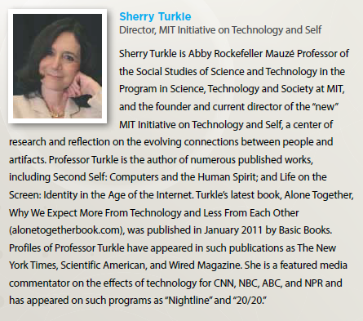

Slide 6
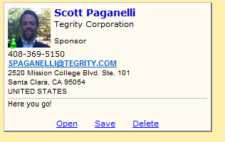
To: Myrene Magabo
From: Scott Paganelli
Company: Tegrity Corporation
Email: SPAGANELLI@TEGRITY.COM
Work Phone: 408-369-5150
Alt Phone:
Address: 2520 Mission College Blvd. Ste. 101
City: Santa Clara
State/Prov: CA
Postal Code: 95054
Country: UNITED STATES

